Slide 1

Self-stabilizing Systems – concept and basic algorithm for mutual exclusion
Project code in - https://github.com/or3005/algorithm_simulator.git
23-1-R-10
Name: Or Biton Supervisor: Prof. Shmuel Zaks
Notes:
Hello, my name is, Or Biton and I will present and explain my project that deals with self-stabilization in distributed systems, by Dykstra's 4-states machine algorithms.

Slide 2
Distributed Systems
A distributed system is a collection of independent computers or programs that utilize share resources to achieve a common goal and they appear to the users as a single coherent system.
Characteristics:
Parallelization : Multiple components execute simultaneously.
Scalability: System can handle increasing workload by adding more resources.
Fault Tolerance: System remains operational despite failures.
Transparency: Users perceive the system as a single entity.
Examples:
Cloud computing platforms
Internet networks
Distributed databases
Notes:
First, let's start with some background on distributed systems and self-stabilization. A distributed system is a collection of independent computers or programs that utilize share resources to achieve a common goal and they appear to the users as a single coherent system. Some important features Concurrency: Multiple components execute simultaneously- for example processors working at the same time in the same computer
Scalability: System can handle increasing workload by adding more resources. That meaning that we can add more machines or possessors to the system easily
Fault Tolerance: System remains operational despite failures. – this is one of the most important feature in my project and in general, if one of the machine have some kind of failure or a bug the system will stabilize itself using Dikstra algorithm, and by this the system is more reliable
Transparency: Users perceive the system as a single entity. – users don’t aware to the individuals inside the system and see it as one. Some example to this system are – Cloud computing platforms
Internet networks- like routers that connecting and using data from one to another
Distributed databases

Slide 3
Self-Stabilization with mutual exclusion
Self-stabilization determines the ability of a distributed algorithm to converge within finite time to a configuration from which its behavior is correct (i.e., satisfies a given specification), regardless of the random initial configuration of the system.
Key Features:
Autonomy: System adapts and corrects itself without external intervention.
Robustness: Resilient to transient faults and initial misconfigurations.
Convergence: Eventually, system converges to a stable state, ensuring correct behaviour.
Applications:
Network protocols
Fault-tolerant systems
Notes:
Now I will elaborate on self Stabilization, this is a concept of fault tolerance and error handling in distributed systems. It determines the ability of a distributed algorithm to converge within finite time to a configuration from which its behavior is correct (i.e., satisfies a given specification), regardless the random initial configuration of the system.
Some of the features -
Autonomy: System adapts and corrects itself without external intervention- in This way we can trust the system in different situations and be sure that if any problem happens, we will not have to allocate resources or personnel to relieve the problem
Robustness: Resilient to passing faults and initial misconfigurations. Since the system is self-correcting, minor errors and wrong input will not break it
Convergence: Eventually, system converges to a stable state, ensuring correct behaviour. When the algorithm runs and checks and changes values, when we have faults or errors, we adjust the system according to the rules of the algorithm

Slide 4
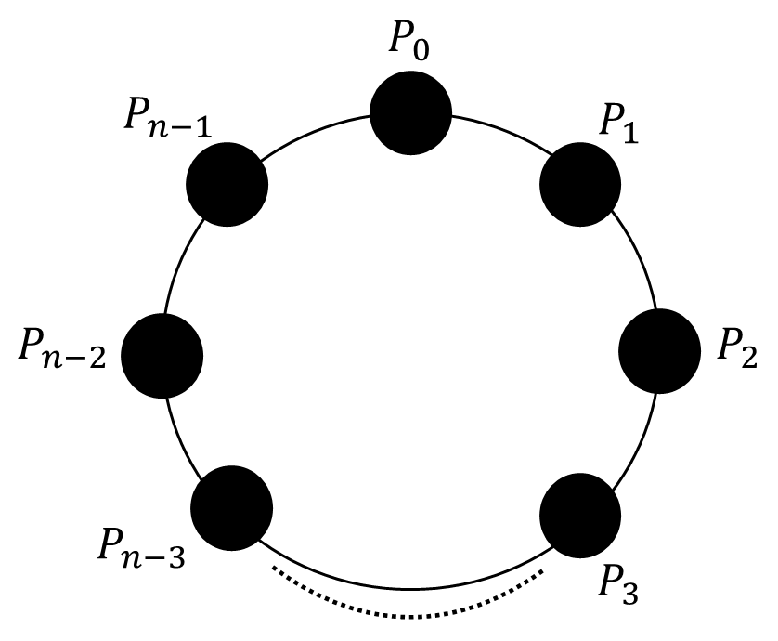
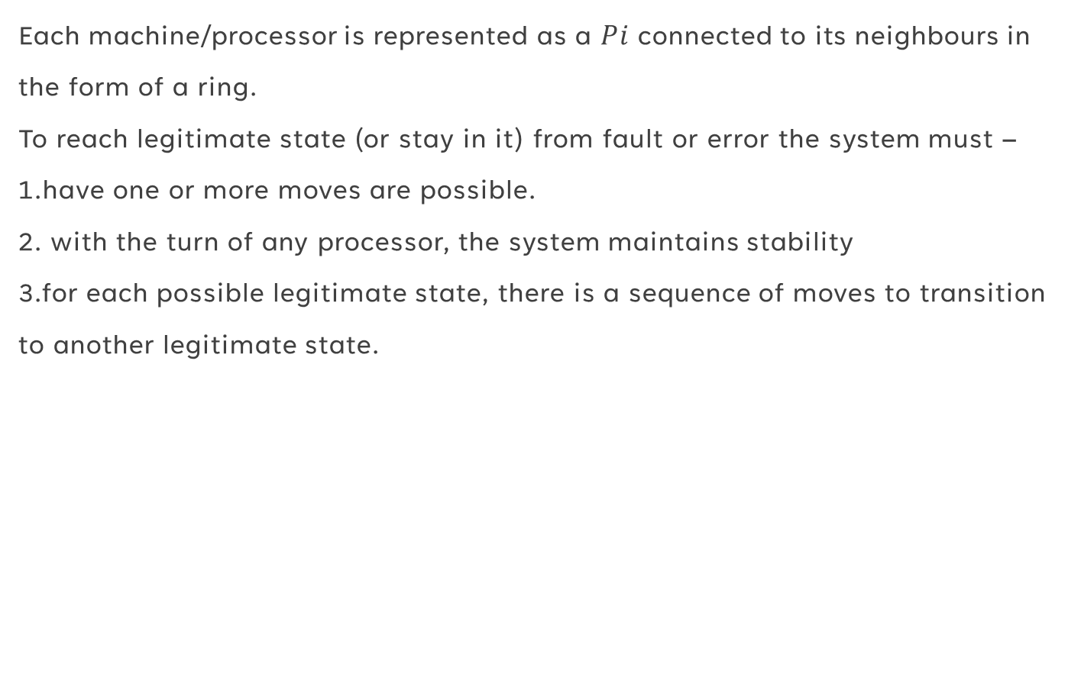
Dijkstra's Four-State Algorithm
Each machine/processor is represented as a $Pi$ connected to its neighbours in the form of a ring. To reach legitimate state (or stay in it) from fault or error the system must – 1.have one or more moves are possible. 2. with the turn of any processor, the system maintains stability 3.for each possible legitimate state, there is a sequence of moves to transition to another legitimate state.
Notes:
In his paper, Dijkstra proposed three self-stabilizing algorithms for achieving mutual exclusion on a ring network in these algorithms, The system consist from n processors represented by P_0, P_1, P_2, ..., P_(n-1), In Dijkstra’s paper, all processors are connected in a circular ring, with each node linked to its left and right neighbours and can see the values in them, we will see Kruijer implementation of this. *** To reach legitimate state (or stay in it) , a state with no faults I will elaborate on this later,or to recover from fault or fatal errors the system must – have one or more moves are possible- at least one of the connected machines can get the token and make a move with the turn of any processor, the system maintains stability, the system can’t make unallowed move that will change the system stability and appose to the algorithm logic
for each possible legitimate state, there is a sequence of moves to get to another legitimate state- we can reach all the combinations of legitimate state from a legitimate state

Slide 5
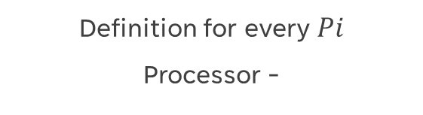
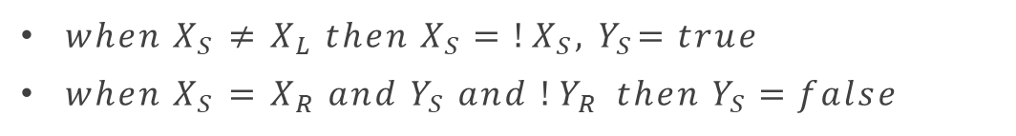
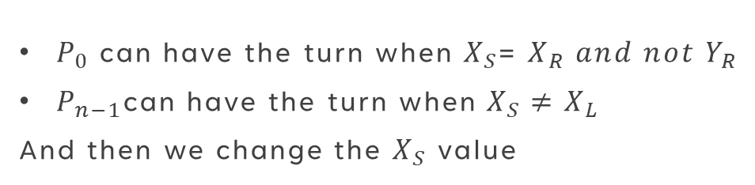

rules in Dijkstra's Four state machines algorithm
Definition for every $Pi$
Processor -
Definition for token passing for special processors
Has two Boolean variables $X_{S} and Y_{S}$
Every $Pi$ can see he’s left and right neighbors Boolean values represent by $X_{L}Y_{L}X_{R}Y_{R}$
$P_{0}$ is the bottom processor,$P_{n−1}$ is the top processor
$P_{0}$ can have the turn when $X_{S}$= $X_{R} and not Y_{R}$
$P_{n−1}$can have the turn when$X_{S}≠$ $X_{L}$
And then we change the $X_{S}$ value
Definition for all of the others -
${when X}_{S}$ $≠$ $X_{L} then{ X}_{S}=!X_{S},{ Y}_{S}=true$
${when X}_{S}$ $=$ $X_{R} and{ Y}_{S} and {!Y}_{R} then{ Y}_{S}=false$
Notes:
This is the rules of disktra algorithm, I will not elaborate on it Because it is not relevant to the rest of the presentation as I dived into more details in the first part of my project, and for the lack of time, In the next slide we will see the implementation of this algorithm by KrUIJER’S TREEs

Slide 6
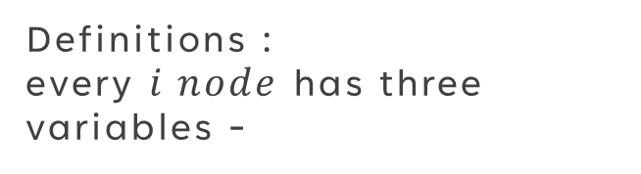
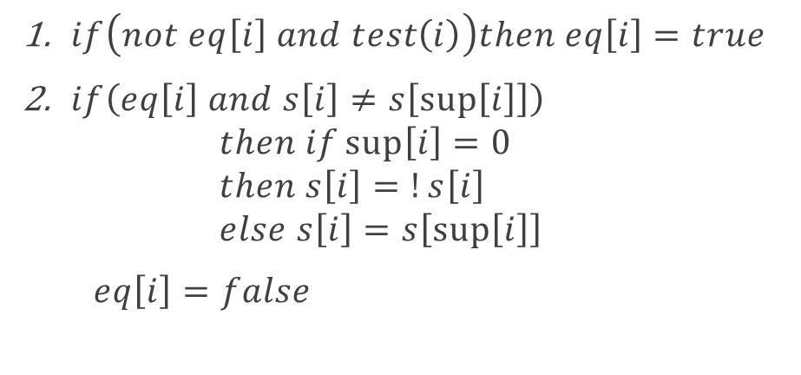
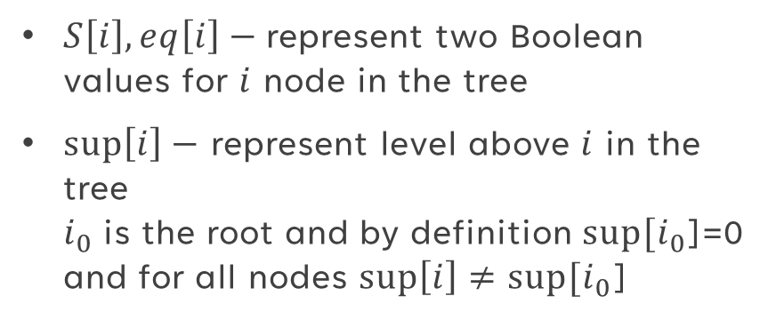
KrUIJER’S TREE
Conditions for getting the token :
Definitions : every $i node$ has three variables -
$if\left(not eq\left[i\right] and test\left(i\right)\right)then eq\left[i\right]=true$
$if\left(eq\left[i\right] and s\left[i\right]≠s\left[\sup\left[i\right]\right]\right)$ $then if\sup\left[i\right]=0$ $then s\left[i\right]=!s\left[i\right]$ $else s\left[i\right]=s\left[\sup\left[i\right]\right]$
$eq\left[i\right]=false$
$S\left[i\right], eq\left[i\right]−$represent two Boolean values for $i$ node in the tree
$\sup\left[i\right]−$ represent level above $i$ in the tree $i_{0}$is the root and by definition $sup⁡[i_{0}$]=0 and for all nodes $\sup\left[i\right]≠sup⁡[i_{0}\text{]}$
Notes:
In his article, Dijkstra did not prove or present a detailed implementation of this algorithm, therefore after many years Kruijer wrote an article about this algorithm in which he presented a new implementation of it with proof and additional theories about it, this article is very important in my project, on its logic and idea the software I created is based and work on, Kruijer changes the data structure from a circle ring to a tree, which gives some flexibility in certain cases and adds more variables that affect the algorithm, one of his theory's is that the system will always stabilize using this algorithm after 2*the number of processors in the system, I researched this theory and will present data About it later. In the new method every processor or node in the tree have two Boolean values represented by si and eqi when I is the processor id number, in addition all nodes have sup value that represent the level of the tree above node I meaning the level of his father, for the root i0 sup always return zero and no node have the same sup value as the root. Now we will talk about the conditions for every possessor to have the turn, firstly if eq value is false and test function return true- I will explain on test in the next slide, then the node can have the turn and when entered we will change his eq value to true. Secondly if eq is true and s value is not the same as the si of the root or the node father, then this node can have the turn, then we check if the current node is the root, if so we change si value, if not we give this not root node the root si value, and any way if we enter this condition, we update eq value to true. With this conditions every node can have the turn only twice at most.

Slide 7
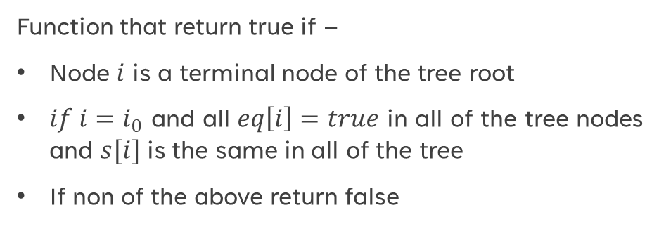
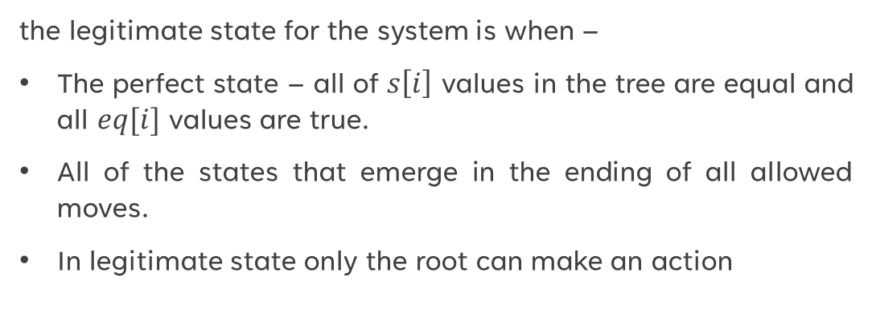
Legitimate states and test condition
Test condition
Legitimate states
Function that return true if –
Node $i$ is a terminal node of the tree root
$if i=i_{0}$ and all $eq\left[i\right]=true$ in all of the tree nodes and $s[i]$ is the same in all of the tree
If non of the above return false
the legitimate state for the system is when –
The perfect state – all of $s\left[i\right]$ values in the tree are equal and all $eq[i]$ values are true.
All of the states that emerge in the ending of all allowed moves.
In legitimate state only the root can make an action
Notes:
Now I will explain about test and the legitimate state and then we will see small example of the tree algorithm, test is a separate function that return true only if the current node is a terminal node- meaning he is not the root, if I node is the root test will return true only when all eq values in the tree are true and all of the si in the tree are the same – if so we can return true and give the turn only for the root, in other cases test will return false. The legitimate state is the state we wish to get in the algorithm, when we reach it we can know that the system is stabilized, and we can continue working with it and pass the token to the privilege nodes. The definition of reaching the legitimate state occurs when all of si values in the tree are the same and all eq values in the tree are true, this state is called the perfect state. All of the states that emerge in the ending of all allowed moves by this algorithm is a legitimate state when we reach the legitimate state only the root can have the turn. As we will see it in the example.

Slide 8
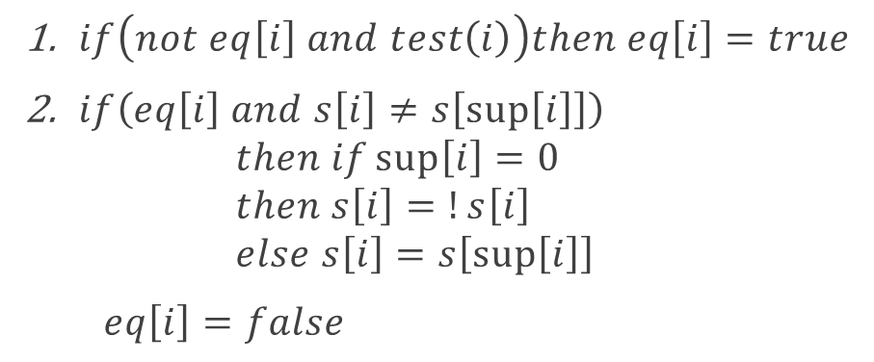
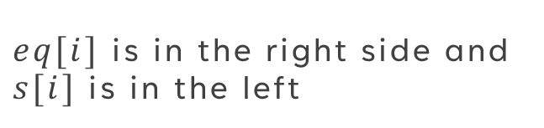
Tree example
$eq[i]$ is in the right side and $s[i]$ is in the left
- +
$if\left(not eq\left[i\right] and test\left(i\right)\right)then eq\left[i\right]=true$
$if\left(eq\left[i\right] and s\left[i\right]≠s\left[\sup\left[i\right]\right]\right)$ $then if\sup\left[i\right]=0$ $then s\left[i\right]=!s\left[i\right]$ $else s\left[i\right]=s\left[\sup\left[i\right]\right]$
$eq\left[i\right]=false$
- +
- +
- +
The system is in legitimate state only the root can have the turn
Notes:
Now I will explain briefly on the Kruijer tree implementation as we will see more trees in the software itself in the simulator, in the left side we can see si values in the nodes and in the right side is the eq value, let us look on this node, his eq value is true meaning he can’t enter the first condition, and we can see that his si values are the same as his father and root value, so he cant get the turn by the second condition, however, if we will look on the root we will notice that he can enter the second condition as his eq value is true as his si value always not equal to level above him as we don’t have level above him as I explained earlier by definition of sup root. I explained in the previvors slide that when the root can make a move we are in legitimate state, as the root will enter to the second condition, we will change his eq and si values, and by doing so the root ill not be able to make another action, however the other nodes can enter the second condition because now there si value are not the same as the root si value and eq are true.

Slide 9
Tree example
$eq[i]$ is in the right side and $s[i]$ is in the left
+ -
$if\left(not eq\left[i\right] and test\left(i\right)\right)then eq\left[i\right]=true$
$if\left(eq\left[i\right] and s\left[i\right]≠s\left[\sup\left[i\right]\right]\right)$ $then if\sup\left[i\right]=0$ $then s\left[i\right]=!s\left[i\right]$ $else s\left[i\right]=s\left[\sup\left[i\right]\right]$
$eq\left[i\right]=false$
- +
- +
- +
Notes:
Here we can see the tree after we updated his values, as you can see now all of the other nodes can enter the second condition as eq is true and si is not the same as in the root

Slide 10
Tree example
$eq[i]$ is in the right side and $s[i]$ is in the left
+ -
$if\left(not eq\left[i\right] and test\left(i\right)\right)then eq\left[i\right]=true$
$if\left(eq\left[i\right] and s\left[i\right]≠s\left[\sup\left[i\right]\right]\right)$ $then if\sup\left[i\right]=0$ $then s\left[i\right]=!s\left[i\right]$ $else s\left[i\right]=s\left[\sup\left[i\right]\right]$
$eq\left[i\right]=false$
- +
+ -
- +
Notes:
Here we can see the tree after we updated his node 2 values, as you can see now all of the other nodes can enter the second condition as eq is true and si is not the same as in the root and node 2 can get inside the first condition

Slide 11
Tree example
$eq[i]$ is in the right side and $s[i]$ is in the left
+ -
$if\left(not eq\left[i\right] and test\left(i\right)\right)then eq\left[i\right]=true$
$if\left(eq\left[i\right] and s\left[i\right]≠s\left[\sup\left[i\right]\right]\right)$ $then if\sup\left[i\right]=0$ $then s\left[i\right]=!s\left[i\right]$ $else s\left[i\right]=s\left[\sup\left[i\right]\right]$
$eq\left[i\right]=false$
- +
+ -
+ -
Notes:
Here is the same run for node 3

Slide 12
Tree example
$eq[i]$ is in the right side and $s[i]$ is in the left
+ -
$if\left(not eq\left[i\right] and test\left(i\right)\right)then eq\left[i\right]=true$
$if\left(eq\left[i\right] and s\left[i\right]≠s\left[\sup\left[i\right]\right]\right)$ $then if\sup\left[i\right]=0$ $then s\left[i\right]=!s\left[i\right]$ $else s\left[i\right]=s\left[\sup\left[i\right]\right]$
$eq\left[i\right]=false$
- +
+ +
+ -
Notes:
And here we can see node 2 get the token again as he can enter the first condition- the token move randomly between all possible moves, and he update eq value

Slide 13
Tree example
$eq[i]$ is in the right side and $s[i]$ is in the left
+ -
$if\left(not eq\left[i\right] and test\left(i\right)\right)then eq\left[i\right]=true$
$if\left(eq\left[i\right] and s\left[i\right]≠s\left[\sup\left[i\right]\right]\right)$ $then if\sup\left[i\right]=0$ $then s\left[i\right]=!s\left[i\right]$ $else s\left[i\right]=s\left[\sup\left[i\right]\right]$
$eq\left[i\right]=false$
+ -
+ +
+ -
Notes:
Here node 1 get the token for the first time enter condition 2

Slide 14
Tree example
$eq[i]$ is in the right side and $s[i]$ is in the left
+ -
$if\left(not eq\left[i\right] and test\left(i\right)\right)then eq\left[i\right]=true$
$if\left(eq\left[i\right] and s\left[i\right]≠s\left[\sup\left[i\right]\right]\right)$ $then if\sup\left[i\right]=0$ $then s\left[i\right]=!s\left[i\right]$ $else s\left[i\right]=s\left[\sup\left[i\right]\right]$
$eq\left[i\right]=false$
+ -
+ +
+ +
Notes:
Node 3 get the token for the second time

Slide 15

Tree example
$eq[i]$ is in the right side and $s[i]$ is in the left
+ -
$if\left(not eq\left[i\right] and test\left(i\right)\right)then ea\left[i\right]=true$
$if\left(eq\left[i\right] and s\left[i\right]≠s\left[\sup\left[i\right]\right]\right)$ $then if\sup\left[i\right]=0$ $then s\left[i\right]=!s\left[i\right]$ $else s\left[i\right]=s\left[\sup\left[i\right]\right]$
$eq\left[i\right]=false$
+ +
+ +
+ +
The system is in legitimate state only the root can have the turn
Notes:
Node 2 get the token for the second time, updated his values and we reached again to a perfect state when all of si values in the system are the same and eq values are true (except from the root) and only the root can make a move, so now the system is stabilized and can continue working

Slide 16
Implementation overview
the goal -
aims to demonstrate the functionality and behaviour of self-stabilizing algorithms in distributed systems.
Helps teach the algorithm and the implementations by trees.
Tests the claim that the system will always stabilize after 2*n operations where n is equal to the number of processors, and displays the data.
Notes:
I had three main goals for my simulator program –
first of all, I want to demonstrate the behavior and functionality of this FOUR0STATE-MACHINE algorithm by the trees in a visual way
the second goal is to be able to teach other students how all of this works.
Lastly to test Krijer's theory that in this method all systems will be stabilized after two times the number of nodes actions, I did research it and I will show interesting data about this

Slide 17
Key components -
1. Nodes and circles :
The system consists of nodes represented by circles, each describes a processor in the distributed network.
Nodes interact with each other to achieve self-stabilization and maintain system stability.
2. Buttons and Controls:
Buttons are utilized for user interaction, allowing for manual execution of the algorithm and observation of system behaviour.
These controls provide a means for pausing, resuming, and stepping through the algorithm's execution.
3. Algorithm Execution:
The core of the code involves the execution of a self-stabilizing algorithm, which mange the behaviour of nodes in the distributed system.
Notes:
A key components from the code- nodes and circles that represent the tree which every one of them holds the Boolean values we talked about earlier and interact with each other and change values
Buttons are utilized for user interaction, allowing for manual execution of the algorithm and observation of system behaviour.
These controls provide a means for pausing, resuming, and stepping through the algorithm's execution.
3. Algorithm Execution:
The core of the code involves the execution of a self-stabilizing algorithm, which mange the behaviour of nodes in the distributed system.

Slide 18
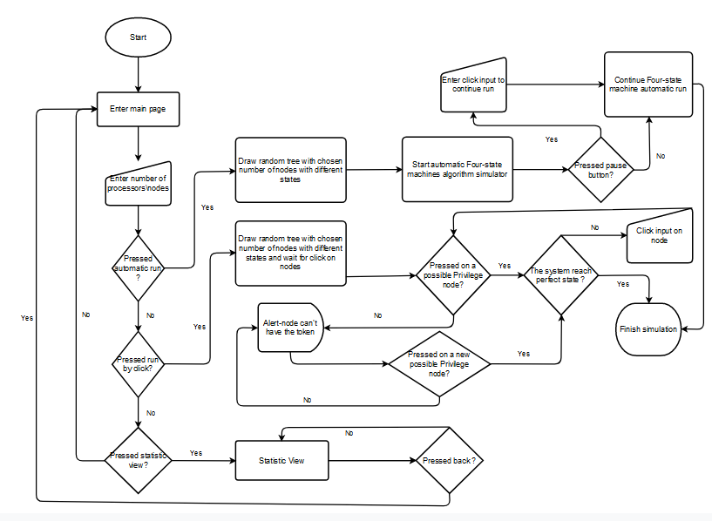
Flow chart
Notes:
Basic flow chart explaining the options in the simulator, in general representation of every click or actions in the software, we will see most of this in the simulator shortly in a better way

Slide 19
Classes
1. Node Class:
Represents individual processors in the distributed system.
Contains attributes such as equality status, privilege status, and state value.
2. NodeCollection Class:
Manages a collection of nodes within the system.
3. Logic Class:
Mange the execution of self-stabilizing algorithm.
Controls the flow of the simulation and updates node states accordingly.
4. HelloApplication Class:
Main class responsible for initializing the JavaFX application.
Sets up the graphical user interface and integrates the logic of the simulation.
Notes:
The main class I use in my code – 1. Node Class:
Represents individual processors in the distributed system.
Contains attributes such as equality status, privilege status, and state value.
Implements methods for executing algorithms and updating node states.
2. NodeCollection Class:
Manages a collection of nodes within the system.
Provides functionality for initializing and accessing nodes based on index.
3. Logic Class:
Mange the execution of self-stabilizing algorithms.
Controls the flow of the simulation and updates node states accordingly.
4. HelloApplication Class:
Main class responsible for initializing the JavaFX application.
Sets up the graphical user interface and integrates the logic of the simulation.

Slide 20
Challenges
Algorithm Understanding:
Understanding the Dijkstra Four-state algorithm required deep research on self-stabilization principles and distributed systems theory.
Implementation Complexity:
Making complex algorithm concepts into practical code was challenging, especially in managing node interactions and ensuring system stability.
Simulation Design: Creating an intuitive and informative simulation of the algorithm that effectively describes its functionality and behaviour to users was a significant challenge.
Notes:
Challenges I faced when working on the project –
1. Algorithm Understanding:
Understanding the Dijkstra Four-state algorithm required deep research on self-stabilization principles and distributed systems theory.
Implementation Complexity:
Making complex algorithm into practical code was challenging, especially in managing node interactions and ensuring system stability.
Simulation Design: Creating an intuitive and informative simulation of the algorithm that effectively describes its functionality and behaviour to users was a significant challenge.

Slide 21
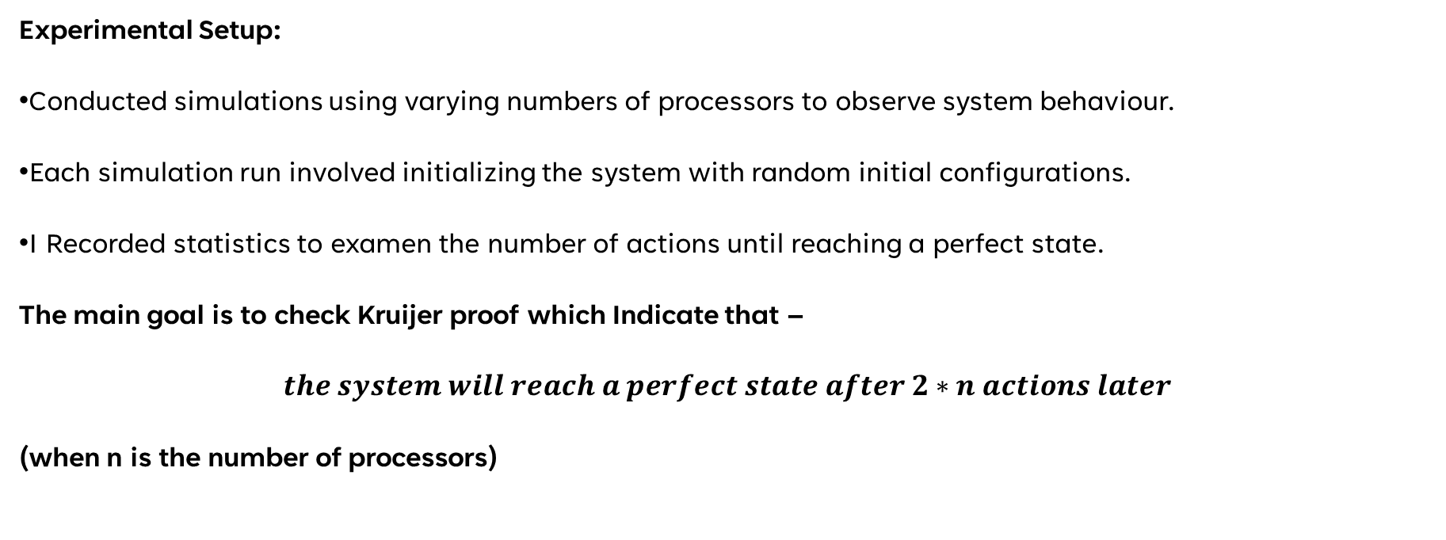
Statistics and Experiments
Experimental Setup:
Conducted simulations using varying numbers of processors to observe system behaviour.
Each simulation run involved initializing the system with random initial configurations.
I Recorded statistics to examen the number of actions until reaching a perfect state.
The main goal is to check Kruijer proof which Indicate that –
$$the system will reach a perfect state after 2∗n actions later$$
(when n is the number of processors)
Notes:
In this slide and the next we can see some of the data I collected to examen Kruijer therom which indicate that the system will reach a perfect state after 2*number of processors moves, I used the simulator we will see shortly for 3,5,10,12,15,18,20 nodes, ten times each when all run have random tree structure with random number of levels and each node have random Boolean values and random number of children, as you can see in the right side in the table not only that by this statistic kruijer was right the average number of actions more close to the number of nodes then twice the number, so in all of this different types of trees with variety of runs, I can say by my reaches this claim is right.

Slide 22
Statistics and Experiments
Number of nodes | Average actions until reaching perfect state
3 | 3.7
5 | 5.1
10 | 11.5
12 | 13.6
15 | 16
18 | 21.1
20 | 23
Notes:
In this slide we can see some of the data I collected to examen Kruijer therom which indicate that the system will reach a perfect state after 2*number of processors moves, I used the simulator we will see shortly for 3,5,10,12,15,18,20 nodes, ten times each when all run have random tree structure with random number of levels and each node have random Boolean values and random number of children, as you can see in the right side in the table not only that by this statistic kruijer was right the average number of actions more close to the number of nodes then twice the number, so in all of this different types of trees with variety of runs, I can say by my reaches this claim is right.

Slide 23
In conclusion
We explored the concept of self-stabilization in distributed systems, where algorithms assemble to a correct state regardless of initial conditions.
Introduced the Dijkstra Four-state algorithm for mutual exclusion on a ring network, focusing on its implementation by Kruijer trees.
Discussed the experimental setup, statistics, and results obtained from simulations, providing insights into system behaviour and performance.
Notes:
A summary of the presentation before I open the simulator We explored the concept of self-stabilization in distributed systems, where algorithms assemble to a correct state regardless of initial conditions.
Introduced the Dijkstra Four-state algorithm for mutual exclusion on a ring network, focusing on its implementation by Kruijer trees.
Discussed the experimental setup, statistics, and results obtained from simulations, providing insights into system behaviour and performance.

